Slide 1
Quantum Associative Memory
Kira Radinsky

Slide 2
Outline
Associative memory
What is it
Hopfield net
Bam Example
Problems
Grover algorithm
Reminder
Example
Quam Algorithm
Modified Grover
Quam Algorithm
Examples
Initializing the Quam memory
Algorithm
Example
O(n – 2)
O(n – 2)

Slide 3
Outline
Associative memory
What is it
Hopfield net
Bam Example
Problems
Grover algorithm
Reminder
Example
Quam Algorithm
Modified Grover
Quam Algorithm
Examples
Initializing the Quam memory
Algorithm
Example
O(n – 2)
O(n – 2)

Slide 4
Associative memory
What is Associative memory?
Remembering something in common parlance usually consists of associating something with a sensory cue
Assume a set P of m binary patterns of length n
Learn to produce one of the full patterns when presented with only partial pattern
Trivial Solution: Store all in RAM
Requires unique address
Lookup table require mn bits to store all patterns
Learning Solution:
Use generalization
Given a partial pattern we find the closest
Notes:
http://www.shef.ac.uk/psychology/gurney/notes/l5/section3_1.html#SECTION0001000000000000000

Slide 5
Associative memory
What it should do?
Completion
Correction
Recall
Example
Hopfield network
Notes:
http://www.shef.ac.uk/psychology/gurney/notes/l5/section3_1.html#SECTION0001000000000000000

Slide 6
Hopfield net - Structure
Activation states Ai
s_{j} - is the state of unit j.
Θ_{i} - is the threshold of unit i.
w_{ij} - weight of the connection weight from unit j to unit i
State’s Energy function
Stable State = Local minima in energy function
Physics model
Ising models
Notes:
Give in class: http://www.comp.nus.edu.sg/~pris/AssociativeMemory/HopfieldModel.html
1. The units in Hopfield nets are binary threshold units, i.e. the units only take on two different values for their states and the value is determined by whether or not the units' input exceeds their threshold. Hopfield nets can either have units that take on values of 1 or -1, or units that take on values of 1 or 0. So, the two possible definitions for unit i's activation, a_{i}, are:
2. Hopfield nets have a scalar value associated with each state of the network referred to as the "energy", E, of the network, where:
This value is called the "energy" because the definition ensures that if units are randomly chosen to update their activations the network will converge to states which are local minima in the energy function (which is considered to be a Lyapunov function). Thus, if a state is a local minimum in the energy function it is a stable state for the network. Note that this energy function belongs to a general class of models in physics, under the name of Ising models.
http://www.neural-networks-at-your-fingertips.com/
http://www3.itu.edu.tr/~okerol/Grovers%20Algorithm_Ferhat%20Karakoc.ppt.pdf
http://www.springerlink.com/content/wp2506r752qv1623/

Slide 7
Hopfield net-Train & Run
Running
Pick a node at random.
The node moves to a state to minimize the energy of itself and its neighbors.
Training
Lowering the energy of states that the net should "remember“
The network will converge to a "remembered" state if it is given only part of the state
Notes:
At each step, pick a node at random. The node's behavior is then deterministic: it moves to a state to minimize the energy of itself and its neighbors. (In contrast, the Boltzmann machine has a stochastic update rule.)

Slide 8
Hopfield-Extensions
During decoding, there are several schemes that can be used to update the output of the units. The updating schemes are
synchronous (or parallel as termed in some literatures),
asynchronous (or sequential), or a combination of the two (hybrid).
Bam
Hetro-associative : 2-way retrieval capabilities

Slide 9
Hopfield net-Example
Phonebook
(implemented on BAM network)

Slide 10
Classic Associative memory – Problems
Correction
Storage
Storing patterns of length n requires:
n neurons
Memory m is limited: m< kn
K typically 0.15 <k<0.5
Solution
Quantum Associative memory
n neurons
Storage capacity of O(2^{n})
Notes:
Demonstration:
http://www.heatonresearch.com/articles/61/page1.html

Slide 11
Outline
Associative memory
What is it
Hopfield net
Bam Example
Problems
Grover algorithm
Reminder
Example
Quam Algorithm
Modified Grover
Quam Algorithm
Examples
Initializing the Quam memory
Algorithm
Example
O(n – 2)
O(n – 2)

Slide 12
Grover Algorithm
Algorithm for database search
Based on accumulating quantum interference
Searching a database of size n classically takes O(n) lookup operations
Grover algorithm takes O(n½) lookup operations

Slide 13
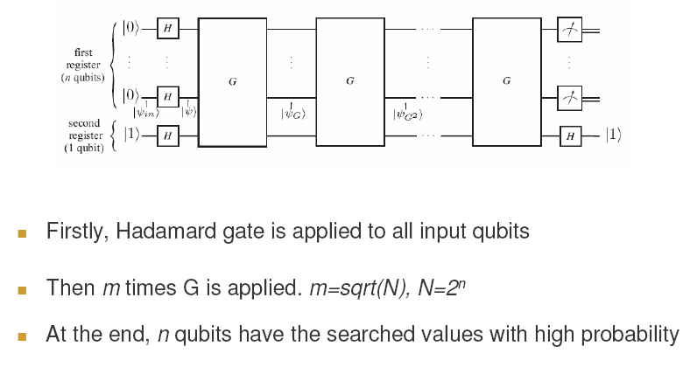
Grover Algorithm

Slide 14
Grover Algorithm

Slide 15
Grover Algorithm

Slide 16
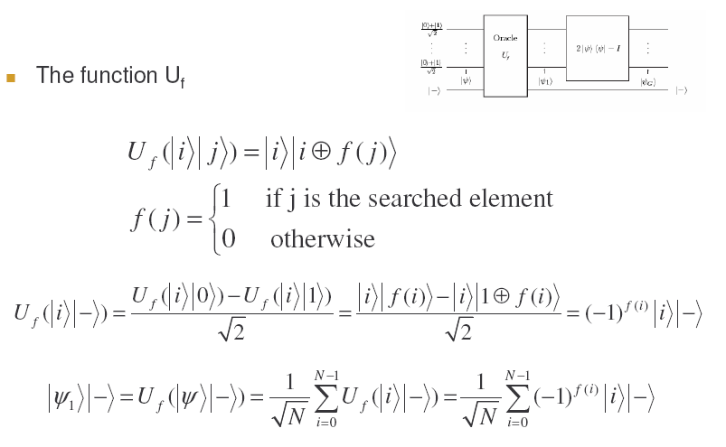
Grover Algorithm

Slide 17
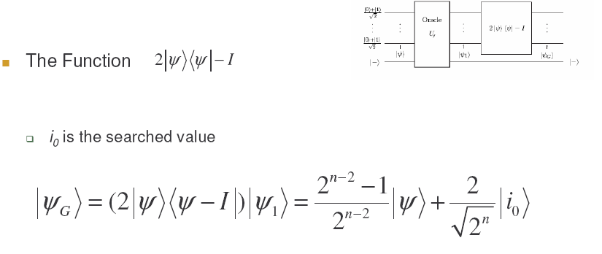
Grover Algorithm

Slide 18
Grover Algorithm
Initialize to |0>
Apply H|0>
Repeat
Apply Îτ
Apply G= -HÎH
Measure
Call the Oracle
Invert amplitudes around the average

Slide 19
Grover Algorithm
Example

Slide 20
Outline
Associative memory
What is it
Hopfield net
Bam Example
Problems
Grover algorithm
Reminder
Example
Quam Algorithm
Modified Grover
Quam Algorithm
Examples
Initializing the Quam memory
Algorithm
Example
O(n – 2)
O(n – 2)

Slide 21
Modified Grover -Motivation
Grover applies to the case where all basis states are represented equally to start with
Can work as associative memory when we memorized all the patterns of length n and we know all n bits of the pattern to be recalled

Slide 22
Modified Grover –Algorithm – first try
Ψ = Initialize to combination of memories
Repeat
Apply Îτ
Apply G= -HÎH
Measure

Slide 23
Modified Grover Algorithm
Example
Notes:
Grover applies

Slide 24
Modified Grover - Problems
Low collapsing probability
Why?
2 undesirable states
Both acquired opposite phases and canceled each other
Thus when rotating above average- the average is smaller
The desired state is rotated above suboptimal average never getting a large probability
Notes:
There are now 2 types of undesirable states:
Those that existed in the superposition to start with but are not the state we are looking for
Those that were not the original superposition but were introduced into the superposition by the G operator

Slide 25
Modified Grover Algorithm – Second try
Ψ = Initialize to combination of memories
Apply G ÎpG Îτ on Ψ
Repeat
Apply Îτ
Apply G= -HÎH
Measure

Slide 26
Modified Grover Algorithm – Second try
Example
Notes:
Grover applies

Slide 27
Quam-Introduction
Instead of |0> start with some other initial distribution – like before
The second state rotation operator rotates the phases of the desired states and also rotates the phases of all the stored patterns as well
Will force the 2 different kinds of undesired states to have the same phase (rather than opposite)

Slide 28
Quam Algorithm
Ψ = Initialize to combination of memories
Apply G ÎpG Îτ on Ψ
Repeat T times
Apply Îτ
Apply G= -HÎH
Measure

Slide 29
Quam Algorithm – What is T?
N – total number of states
R1 – number of marked states that correspond to stored patterns
R0 - number of marked states that do not correspond to stored patterns
P- number of stored patterns

Slide 30
Quam Algorithm – What is T?
Average amplitude of marked states
Average amplitude of unmarked states

Slide 31
Quam Algorithm
Working example - recall
Working example - completion
Example of correction
or non- correction
Non working example

Slide 32
Quam Algorithm
2n + 1 neurons (qubits)
Stores up to N= 2^n patterns
O(MN steps)
Requires O(sqrt(N))

Slide 33
Outline
Associative memory
What is it
Hopfield net
Bam Example
Problems
Grover algorithm
Reminder
Example
Quam Algorithm
Modified Grover
Quam Algorithm
Examples
Initializing the Quam memory
Algorithm
Example
O(n – 2)
O(n – 2)

Slide 34
Initializing Quam
Given a set T of m examples of a function f, the goal is to produce
can be constructed using a polynomial number in m and n of elementary operations on 1,2 or 3 qubits

Slide 35
Initializing Quam – 2 qubit operators
p is the number of patterns including the
current one yet to be processed
These operators form a set of conditional Hadamard-like transforms that will be used to incorporate the example set into a coherent state

Slide 36
Initializing Quam – 2 qubit operators
Flips the state of the qubit
Conditionally flips the second qubit ⬄ the first qubit is in the |0> state
Conditionally flips the second qubit ⬄the first qubit is in the |1> state

Slide 37
Initializing Quam – 3 qubit operators
Identify specific states in a superposition, similar to Grover’s identification of which state should be phase-rotated
A 3 qubit generalization of F
Always used with the third qubit in the |0> state and thus it almost always performs AND on the negation of the first 2 qubits, setting the 3rd to |1> ⬄ the first 2 qubits are |00>

Slide 38
Initializing Quam – Quantum state
3 quantum registers:
x register – holds a superposition of the examples in the set T.
n qubits
value f of the example is used as the coefficient of the state corresponding to the example
g and c registers - contain only ancillary qubits and are restored to the state |0> in the end of the algorithm

Slide 39
Initializing Quam – Intuition
The system is initially in the state |0>
The qubits in x are conditionally flipped so that their states correspond to the 1st example
The S operator corresponding to that example changes the basis of the system such that one of the states has a coefficient that matches example’s f value
The same state is changed to one outside the subspace affected by the S operators, thus making it permanent
Repeat process for each example
In the end we receive a superposition of the examples with equal amplitudes, and different phases corresponding to the f value of the example.

Slide 40
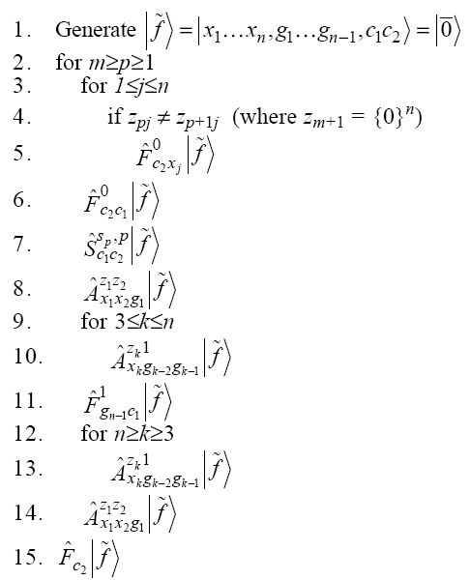
Initializing Quam – Algorithm

Slide 41
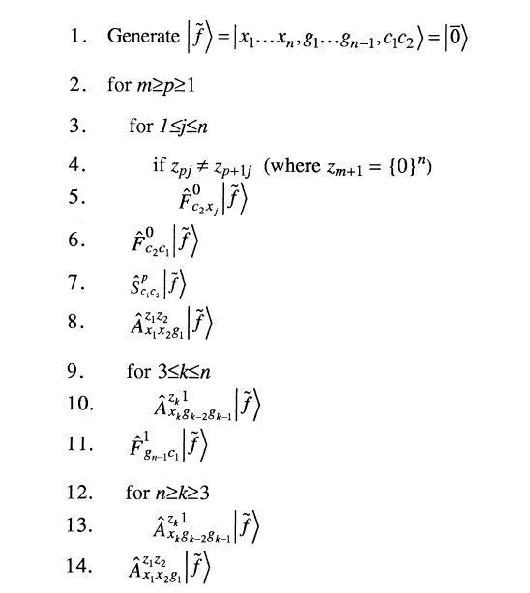
Initializing Quam – Complexity
O(n) (number of examples) operations
3 * O(1) operations
O(n – 2)
O(n – 2)

Slide 42
Initializing Quam – Complexity
The entire algorithm requires m(n+3 + n – 2 + 1 + n- 2 +1) + 1= m( 3n + 1) = O(mn)
Notice that just reading each instance is O(mn)
O(n – 2)
O(n – 2)

Slide 43
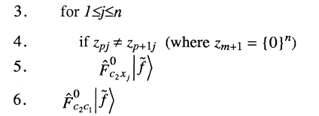
Initializing Quam – Example
O(n – 2)
the qubit states of the x register are flipped to match the first example, and the c register is marked so it will be affected by the S operator
O(n – 2)

Slide 44
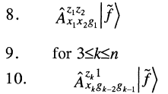
Initializing Quam – Example
Create new state in the superposition
Mark the g registers
O(n – 2)
One of the marked states is made permanent by setting its c register to 01 and this state now
represents the first example. The c register of the other state is returned to 00 , and it is ready to generate a new state.
O(n – 2)

Slide 45
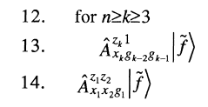
Initializing Quam – Example
Finally the work done in the g register is undone
O(n – 2)
O(n – 2)

Slide 46
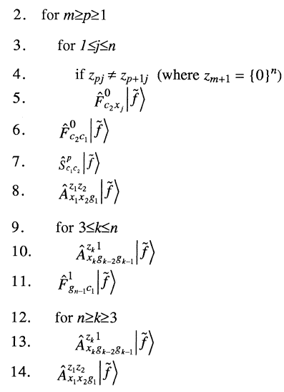
Initializing Quam – Example
Notice the first example is not affected
The 2 states just affected by S are marked in the register
The c register is used to save another state (2nd example)
O(n – 2)
Reset the g register preparing for the process to be
repeated
O(n – 2)

Slide 47
Initializing Quam – Example
only those qubits corresponding to bits that differ in the second and third examples are flipped, in this case just qubit x2.
the generator state is now left with a magnitude of 0, because there are no more examples to process.
O(n – 2)
O(n – 2)

Slide 48
Initializing Quam – Example Finished!
Line 15: restoring all the ancillary qubits to their initial state.
O(n – 2)
O(n – 2)

Slide 49
Initializing Quam – Why is work?
Whenever the S operator is applied, there are no states with the c register in |11>. It allows the operations to be unitary without generating extraneous states.
The ability to identify a specific state in the superposition using the AND operators.
O(n – 2)
O(n – 2)

Slide 50
Conclusions
Quantum associative memory still to be revised
Initializing the Quam memory could be a breakthrough in other related quantum problems
O(n – 2)
O(n – 2)

Slide 51
Refrences
Bam
Wang , Cruz and Mulligan ‘Two coding strategies for biderectional associative memory’, IEEE trans neural netwroks, vol 1 pp 81-92, March 1990
Grover algorithm
Grover L.K “A fast quantum mechanical algorithm for database search”, Proceedings, 28th Annual ACM Symposium on the Theory of Computing, (May 1996) p. 212
Quam
Dan Ventura and Tony Martinez, “Quantum associative memory”, Information Sciences 124 (2000) 273±296, 20 February 1999
Initializing Quam
Dan Ventura and Tony Martinez, “Initializing the amplitude distribution of a quantum state”, Physical Review Letters, June 16 1998

